Slide 1
Software Testing
Lecture 1
Madiha Malik

Slide 2
Course Information
Level: BS
Category: Elective
Credit Hours: 3
Semester: Fall 2019
Course Objectives
This course focuses on testing techniques and tools for software systems. Students will learn importance of testing, testing techniques, testing process and selected open source testing tools.
Text Book:
Naik and Tripathy, Software Testing and Quality Assurance—Theory and Practice, Wiley, 2008.
Reference Book:
Anne Mette Jonassen Hass, Guide to Advanced Software Testing, Artech House, 2008.
Lee Copeland: A Practitioners Guide to Software Test Case Design, Artech House Publishers, 2004
Julian Harty, A Practical Guide to Testing Wireless Smartphone Applications, Morgan and Clay Pool, 2010.

Slide 3
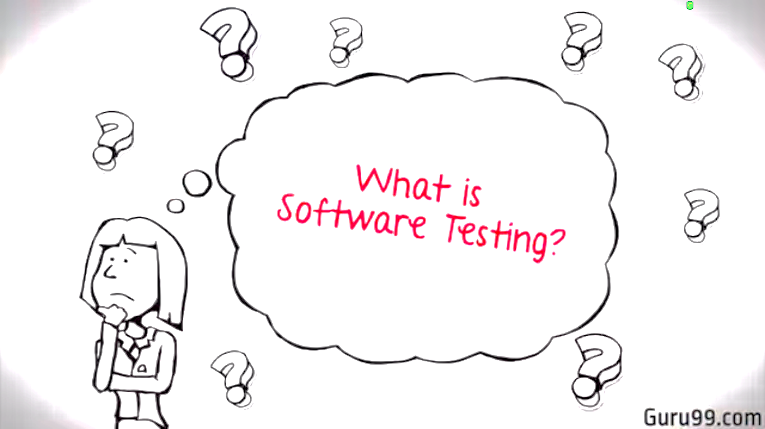

Slide 4
What is Software Testing
Software testing is a process used to identify the correctness, completeness, and quality of developed computer software. It includes a set of activities conducted with the intent of finding errors in software so that it could be corrected before the product is released to the end users.

Slide 5
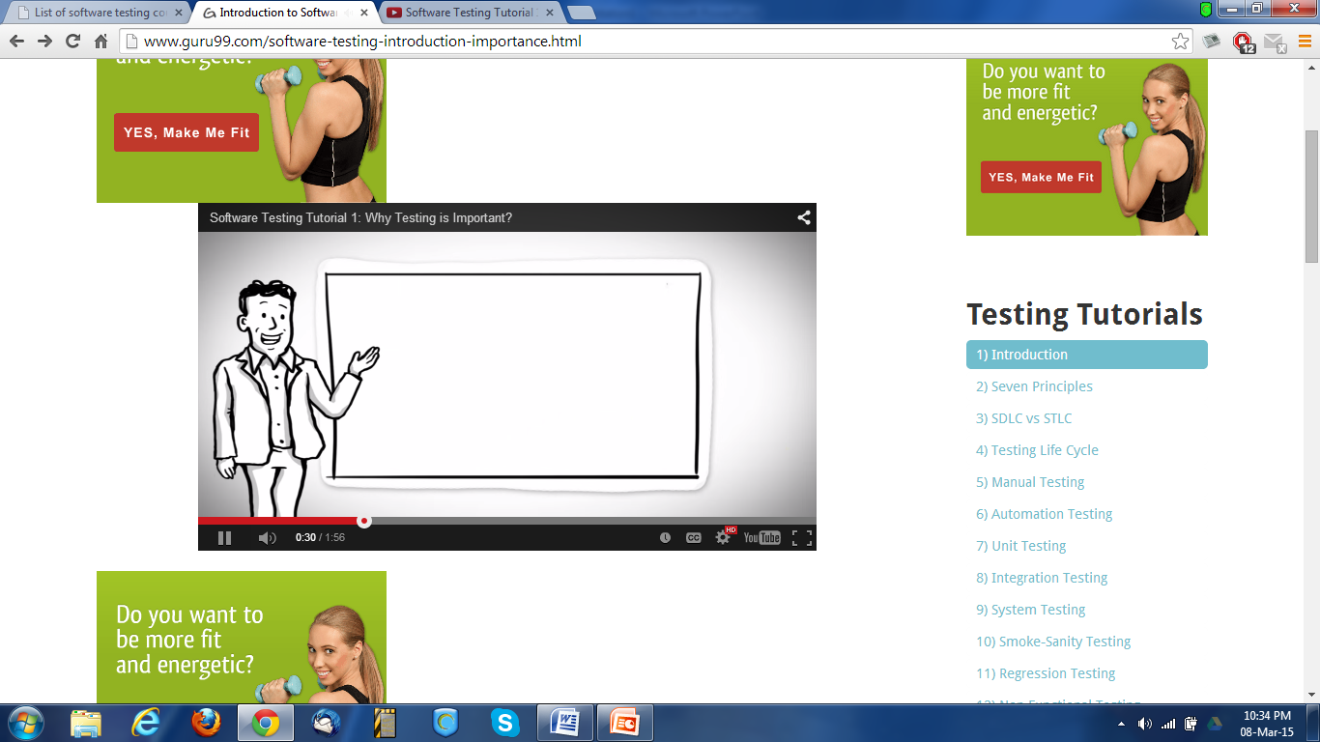
In simple words, software testing is an activity to check whether the actual results match the expected results and to ensure that the software system is defect free.

Slide 6
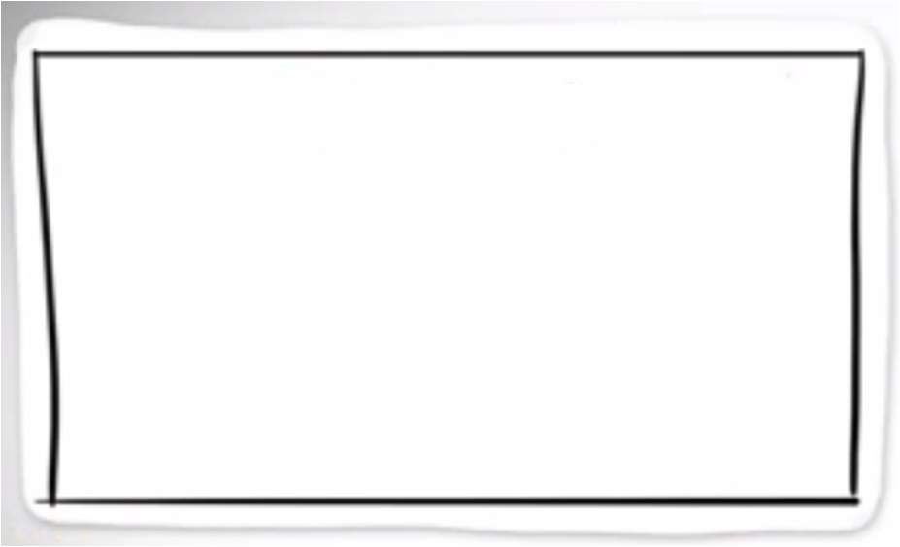
Software Quality
What is software quality?
Many answers depending on whom you ask, under what circumstances, for what kind of software systems, and so on.
An alternative question with informative answers would be:
What are the characteristics for high-quality software?
To answer this:
We need to examine the different perspectives and expectations of users as well as other people involved with the development, management, marketing, and maintenance of the software products.
We also need to examine the individual characteristics associated with quality and their inter-relationship, and focus our attention on the critical characteristics of functional correctness.

Slide 7
Different Views of Quality
Transcendental view: quality is hard to define or describe in abstract terms, but can be recognized if it is present. It is generally associated with some intangible properties that delight users.
User view: quality is fitness for purpose or meeting user’s needs.
Manufacturing view: quality means conformance to specifications.
Product view: the focus is on inherent characteristics in the product itself in the hope that controlling these internal quality indicators (or the so-called product internal metrics) will result in improved external product behavior (quality in use).
Value-based view: Quality, in this perspective, depends on the amount a customer is willing to pay for it.
Software testing is a process used to identify the correctness, completeness, and quality of developed computer software. It includes a set of activities conducted with the intent of finding errors in software so that it could be corrected before the product is released to the end users.

Slide 8
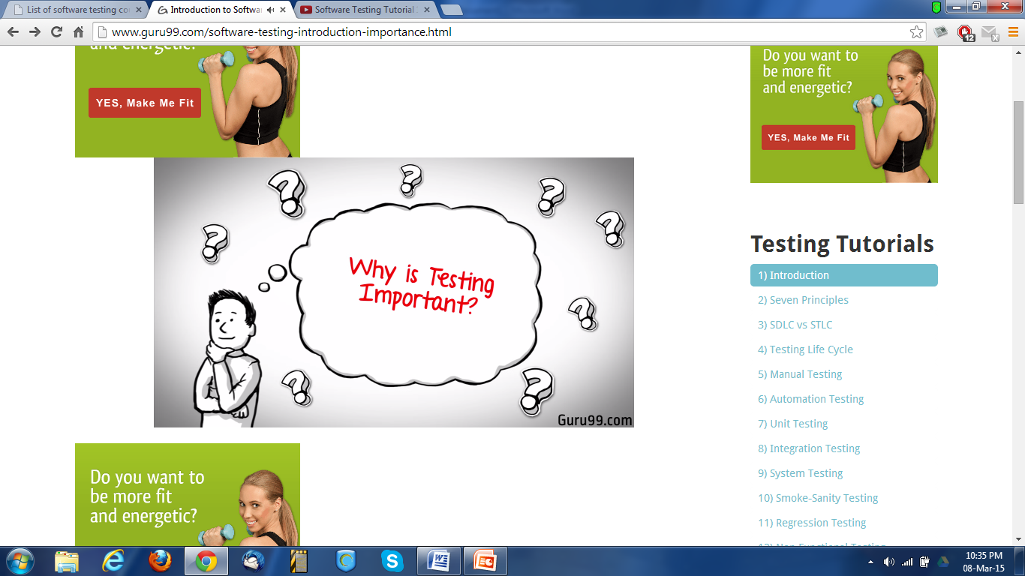

Slide 9
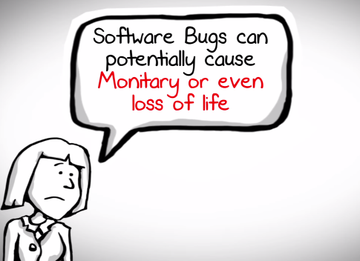

Slide 10
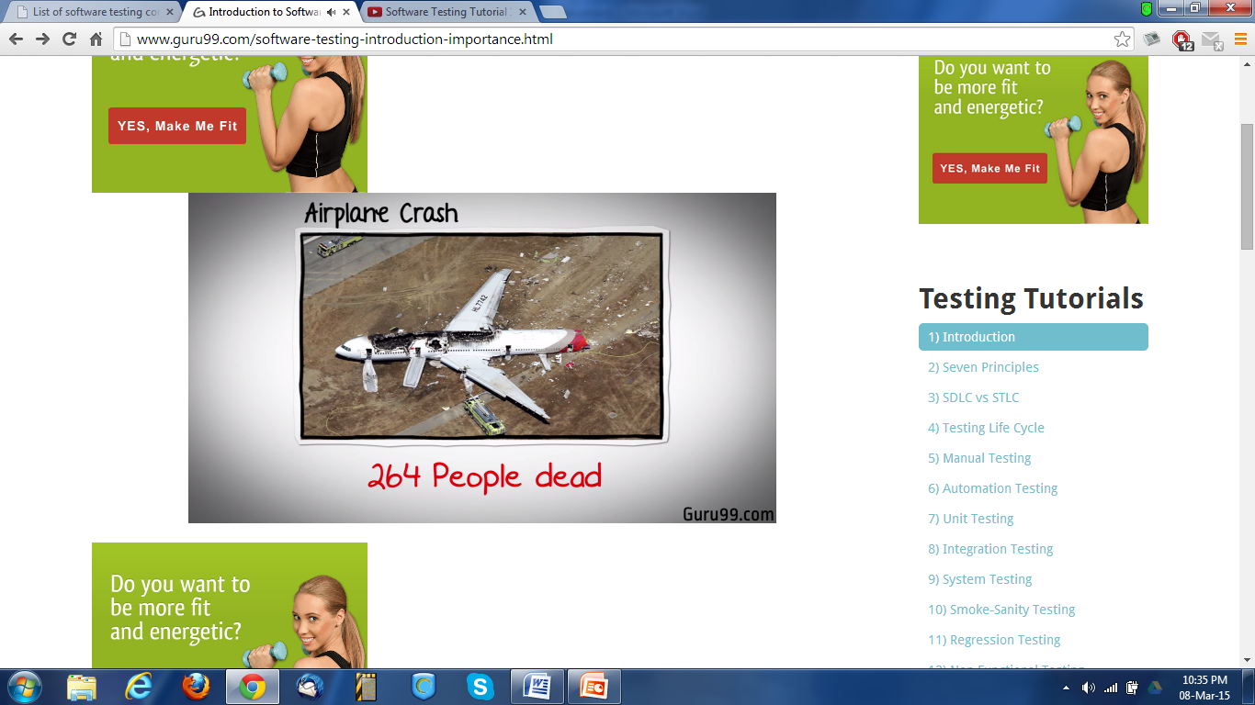
This is China Airlines Airbus A300 crashing due to a software bug on April 26, 1994 killing 264 innocent lives.
Notes:
Software bug - cryptic and misleading output displayed by the tracking software

Slide 11
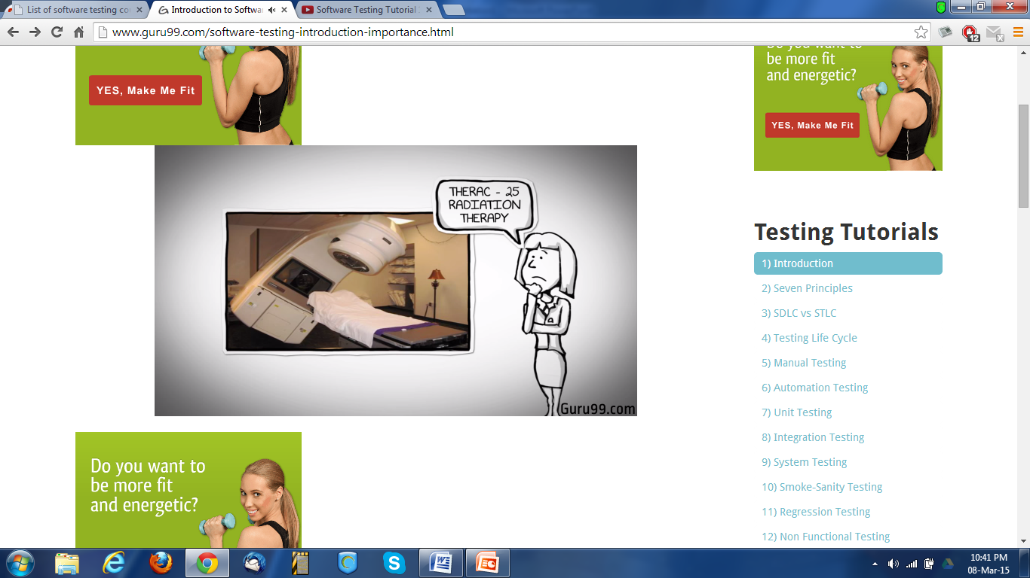
In 1985,Canada's Therac-25 radiation therapy machine malfunctioned due to software bug and delivered lethal radiation doses to patients, leaving 3 people dead and critically injuring 3 others.

Slide 12
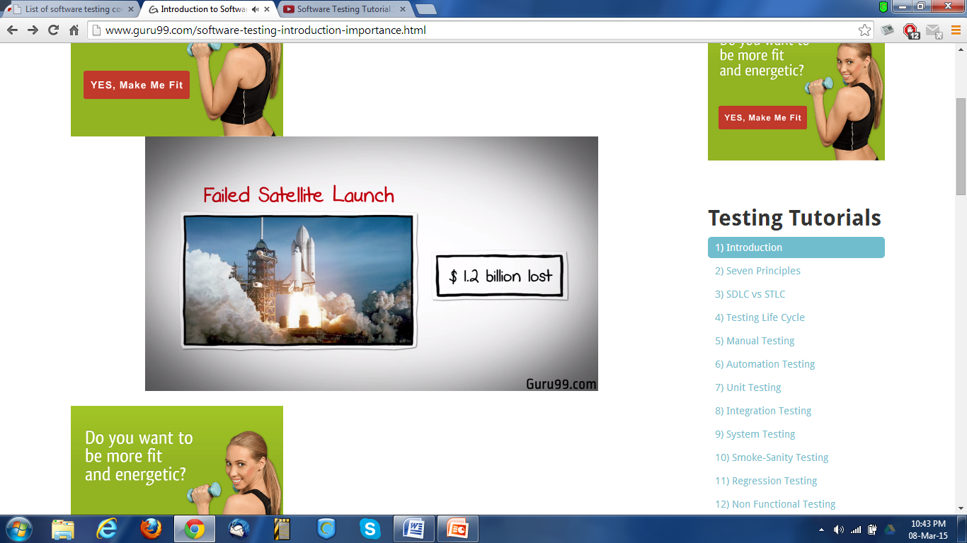
In April of 1999 ,a software bug caused the failure of a $1.2 billion military satellite launch, the costliest accident in history

Slide 13
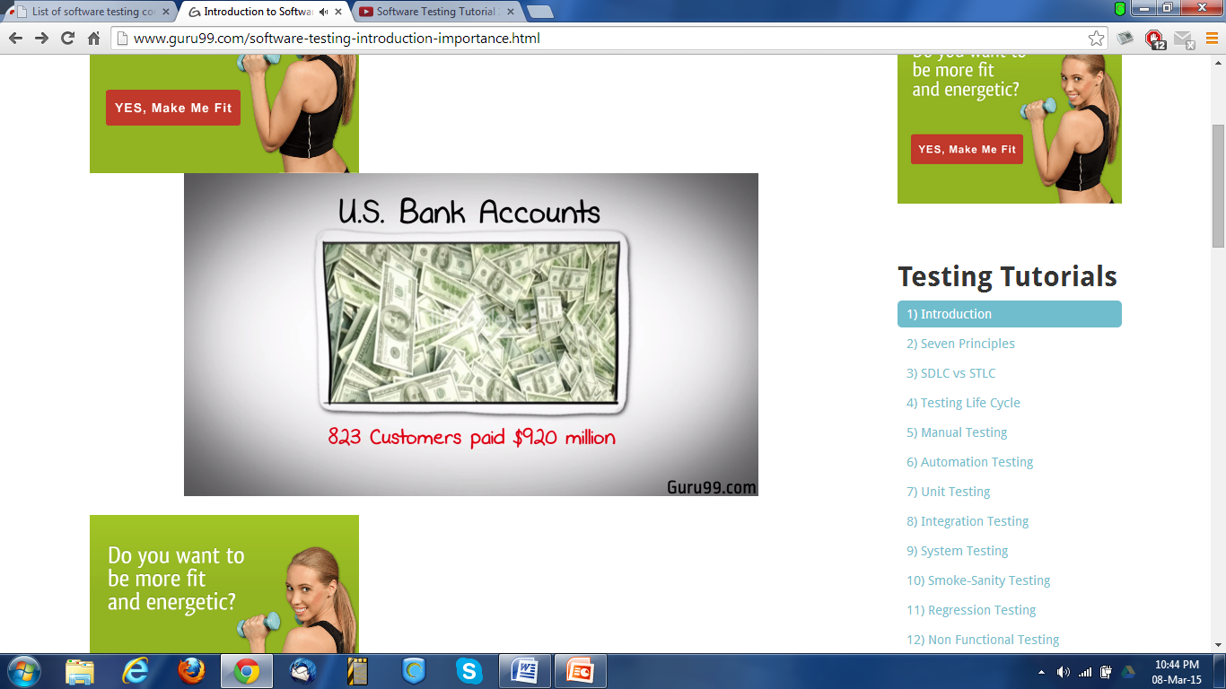
In may of 1996, a software bug caused the bank accounts of 823 customers of a major U.S. bank to be credited with 920 million US dollars

Slide 14
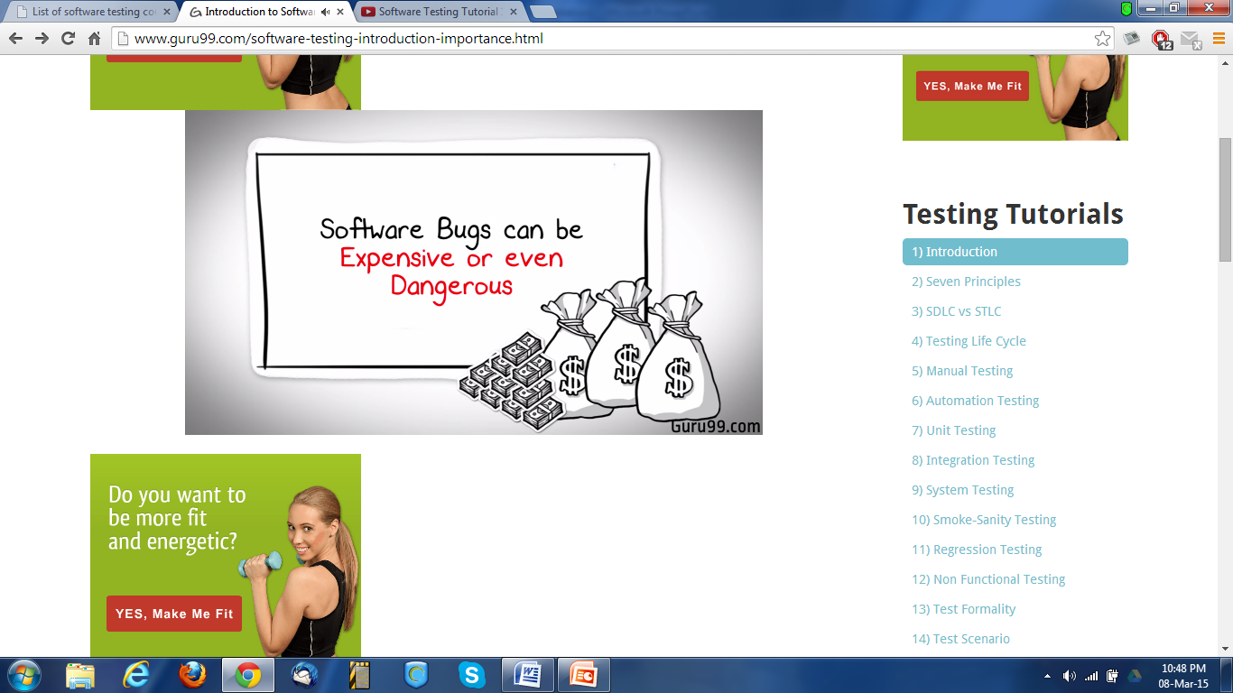

Slide 15
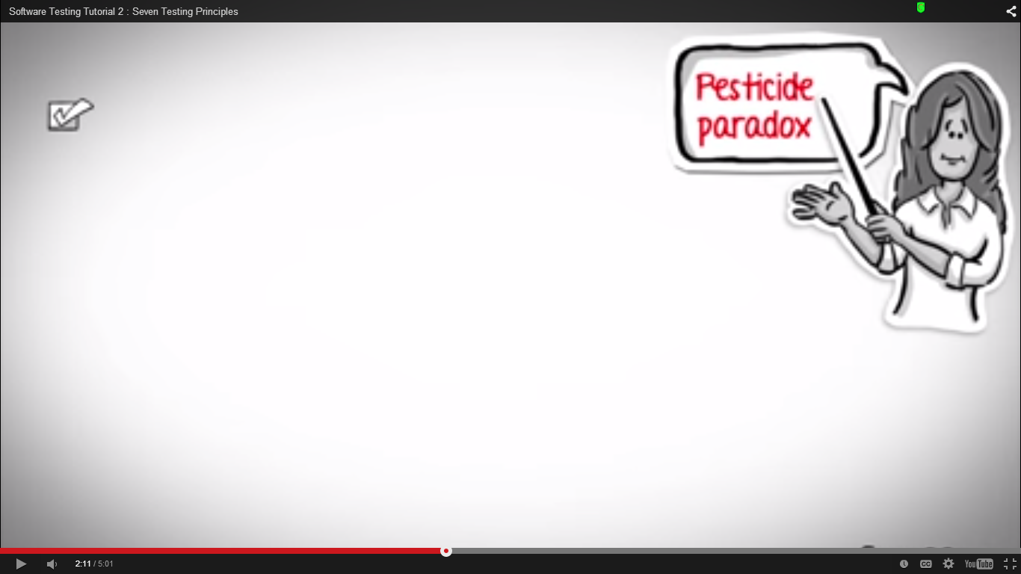
Why Testing?
Software Testing is important as it may cause mission failure, impact on operational performance and reliability if not done properly.
Effective software testing delivers quality software products satisfying user’s requirements, needs and expectations.

Slide 16
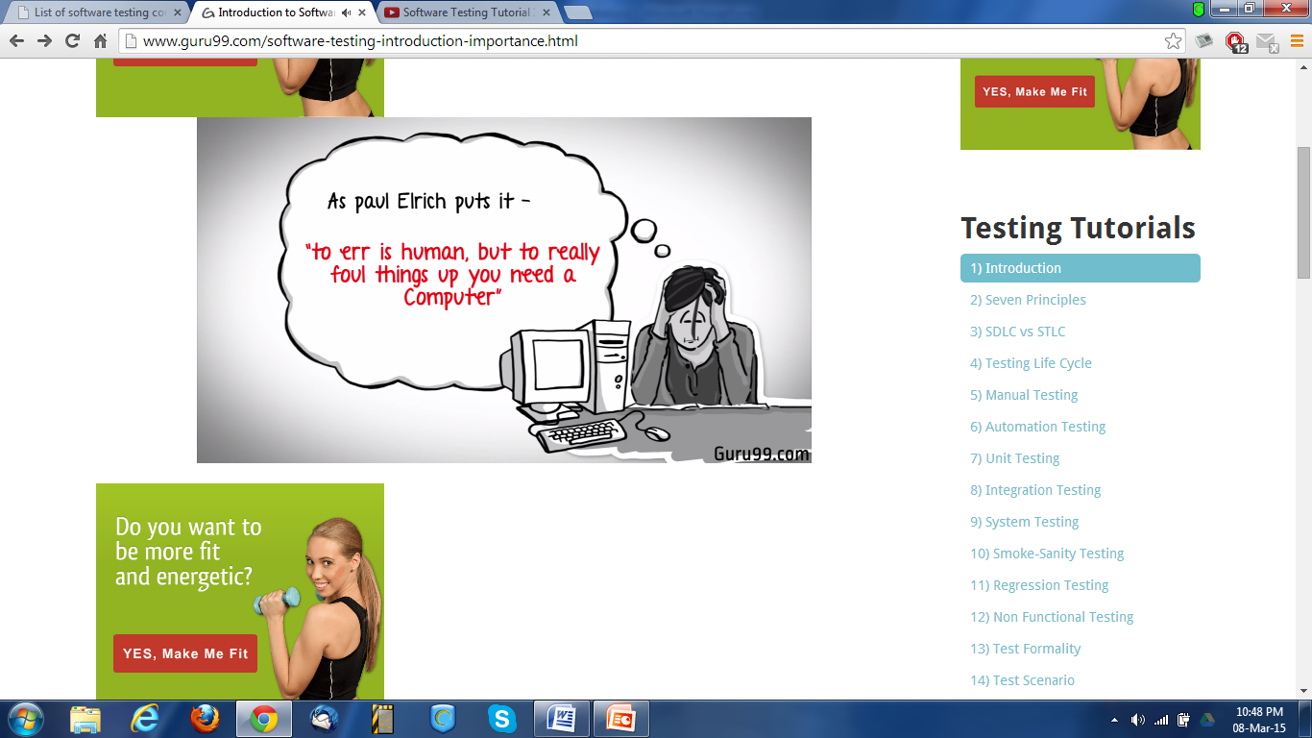

Slide 17
Who should Test?

Slide 18
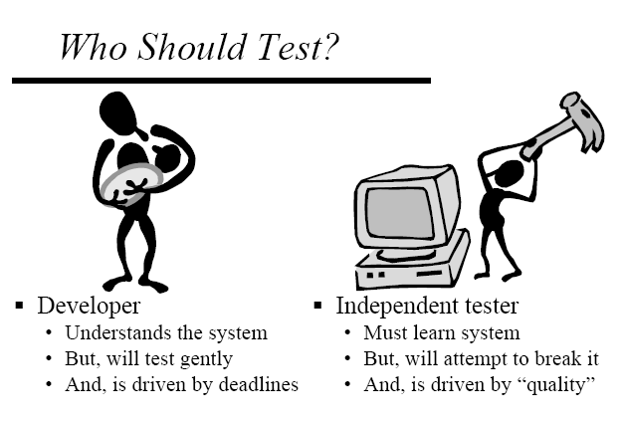
Developer
Understands the system
But, will test gently
And, is driven by deadlines
Independent Tester
Must learn system
But, will attempt to break it
And, is driven by “quality”

Slide 19

What is an
“ERROR”
“Bug”
“Fault”
“Failure”

Slide 20
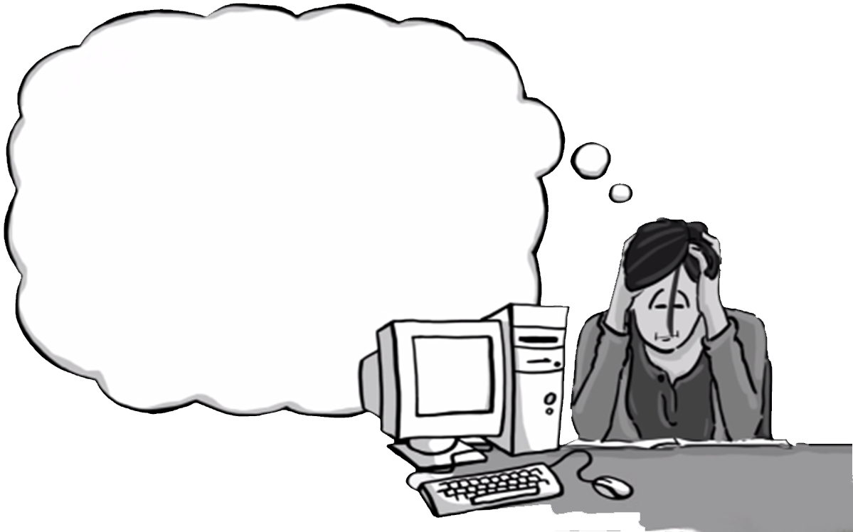
A person makes an Error
That creates a fault in software
That can cause a failure in operation

Slide 21

Difference
Error : An error is a human action that produces the incorrect result that results in a fault.
Bug : The presence of error at the time of execution of the software.
Fault : State of software caused by an error.
Failure : Deviation of the software from its expected result. It is an event.

